Slide 1
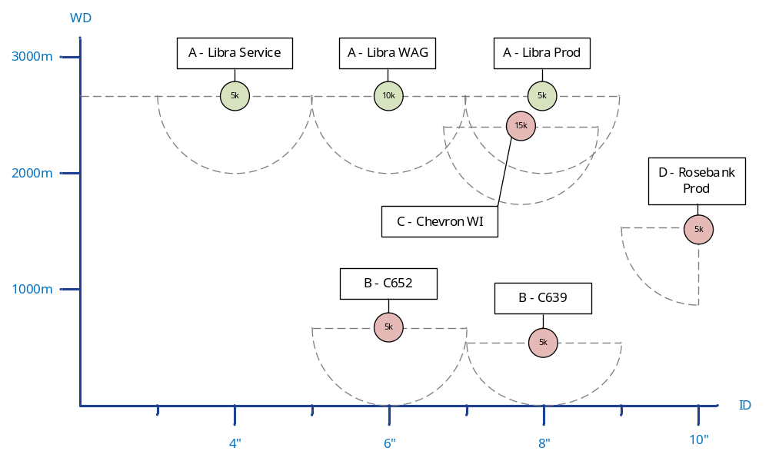
Oct 16
R166 Composites Development Program – Qualification Structures
R166 Key Objectives
Manufacturing Qualification
Design Guidelines
Design Tools
Product Structures Qualification
MOC for Additional Structures
MOC for Additional Materials
 |  | Press | Temp | Barrier & Matrix Material | Comments | PRD
A | Service | 5ksi | 110 | PVDF |  | Y
 | Water & Gas | 10ksi | 60 | PA12 | PERT? | Y
 | Production | 5ksi | 110 | PVDF |  | Y
B | Water Injection | 5ksi | 60 | PA12 | PERT? | N
 | Water Injection | 5ksi | 60 | PA12 | PERT? | N
C | Water Injection | 15ksi | 40 | PA12 | PERT? | N
D | Production | 5ksi | 120 | PVDF |  | N

